Slide 1

Detection of Fluoride Content in Black Tea using Electronic Nose
Istifa Shania Putri, S.Si
Dr. Danang Lelono, S. Si., M.T

Slide 2
Outline
Introduction
Problem formulation & Goal of research
Tools and materials
System framework
Pre-processing
PLSR
Reference concentration
DoE
Results & Performance measurement
Conclusion

Slide 3
Introduction
Fluoride in black tea is a topic of ongoing health debates due to its potential benefits and concerns about fluorosis risk.
Measuring fluoride in black tea is crucial because it affects the quality and safety of this popular beverage.
Existing methods for measuring fluoride in black tea are typically expensive and have limitations in their capabilities.

Slide 4
Problem Formulation
Scope of problem
The using of electronic nose is still limited to the identification and classification of food variety, so a method is needed to estimate concentration of compounds to know using electronic nose.
The data used comes from previous research
This research focus on software
E-nose that been used is on optimal condition
E-nose was used to detect any fluoride content in sample

Slide 5
Goal of research
Benefit of research
Develop fluoride content detection system using e-nose and PLSR .
The benefit of this research is may estimate fluoride content in tea based on the aroma trend produced.

Slide 6
Tools and Materials
Tea:
Broken Orange Pecco (BOP)
Broken Pecco (BP II)
Bohea
PC
Jupyter notebook
Excel

Slide 7
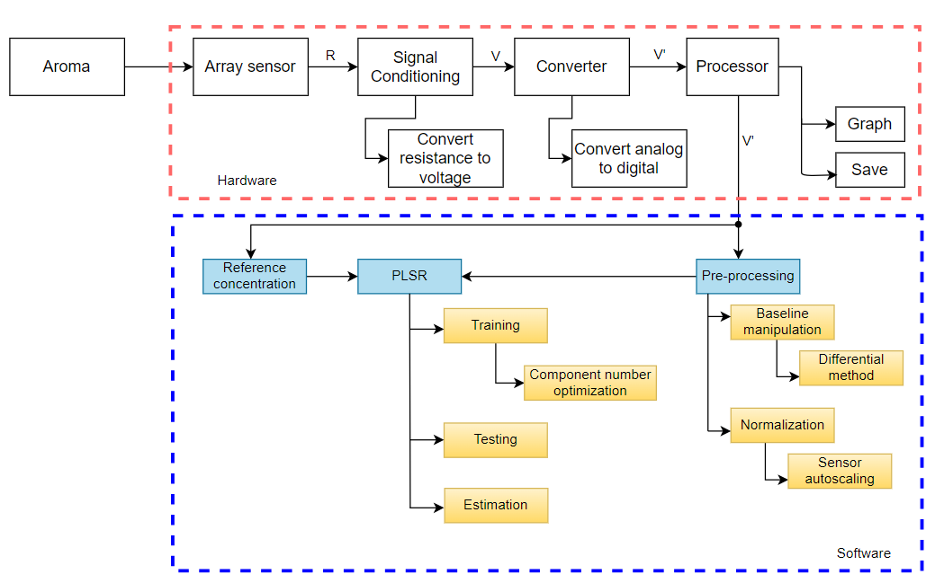
System Framework

Slide 8
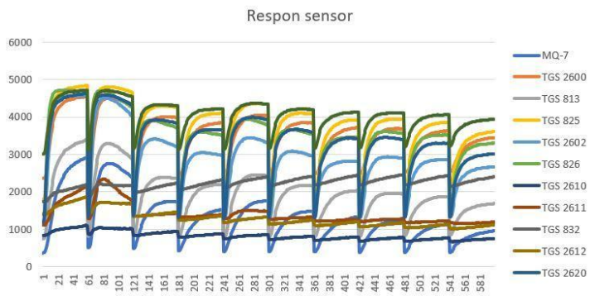
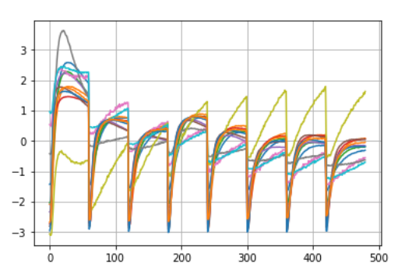


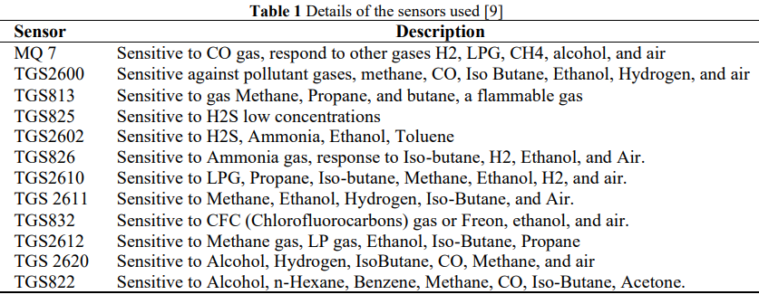
Pre-Processing

Slide 9
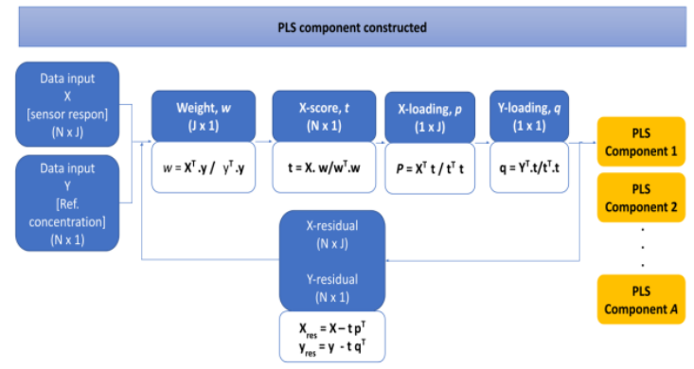
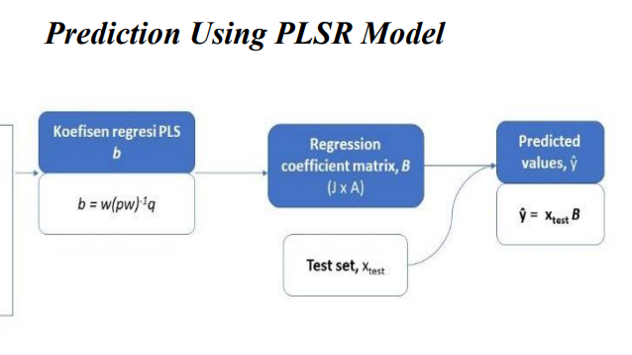
Partial Least Square Reg. (PLSR)

Slide 10
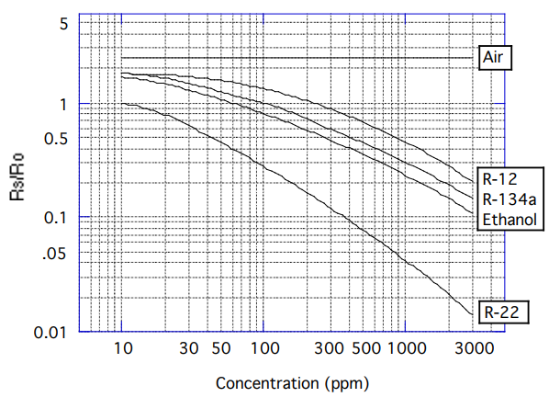
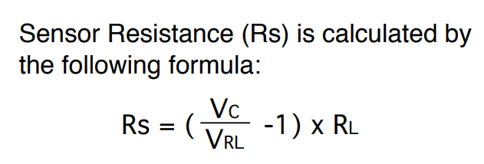
Reference Concentration
Sensitivity characteristics TGS832
Reference concentration (Sabilla, 2017):
Concentration Ref= Rs/Ro

Slide 11
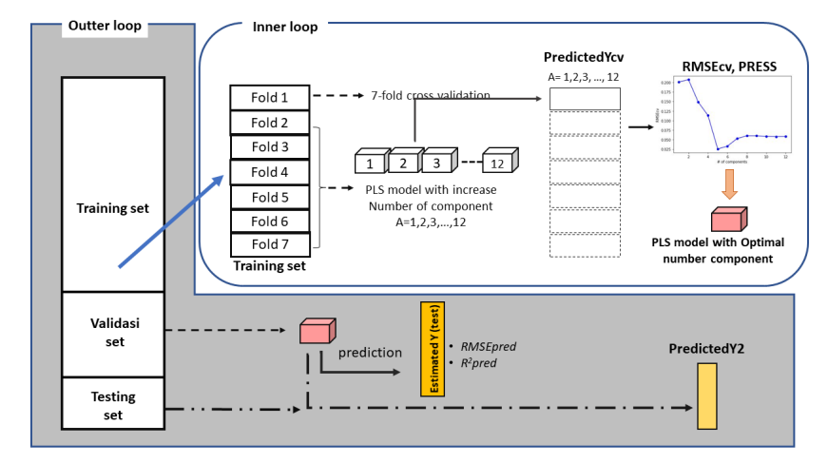
Design of Experiment
Notes:
Di beberapa riset 7 k flod perhaps lebih stabil, ya intinya carilah asalannya
Preess itu apa sedcqrq ringkas,

Slide 12
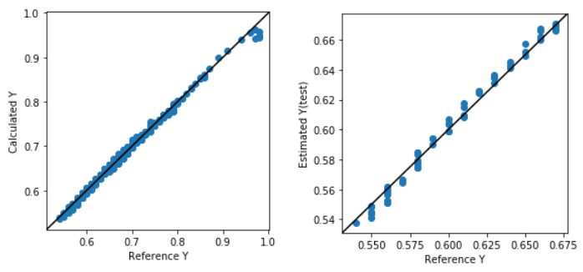
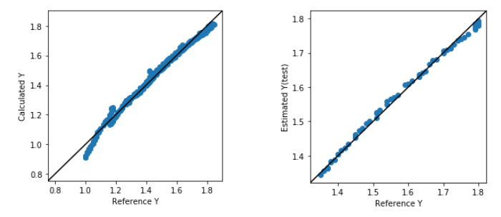
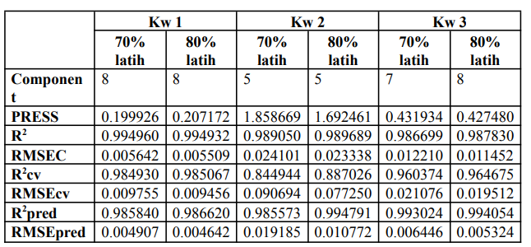
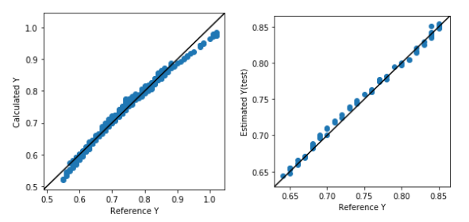
Result and Findings
KW1
KW2
KW3

Slide 13
Performance Measurement
Var. | Avg Estimation (ppm)
KW1 | 0.676936
KW2 | 1.357968
KW3 | 0.803479
KW1
KW2
KW3

Slide 14
Conclusion
Our software system, utilizing the PLSR method, successfully estimate fluoride concentration by referencing Rs/Ro in the aroma of three different qualities of black tea.
The predictive performance based on the Rs/Ro reference for each tea quality proved to be satisfactory, affirming the system's accuracy and potential for practical use.
The analysis revealed that there is no observed positive correlation between the quality of black tea and the fluoride content estimation within black tea.

Slide 15
THANK YOU

